Slide 1

Landspítali – University Hospital

Slide 2
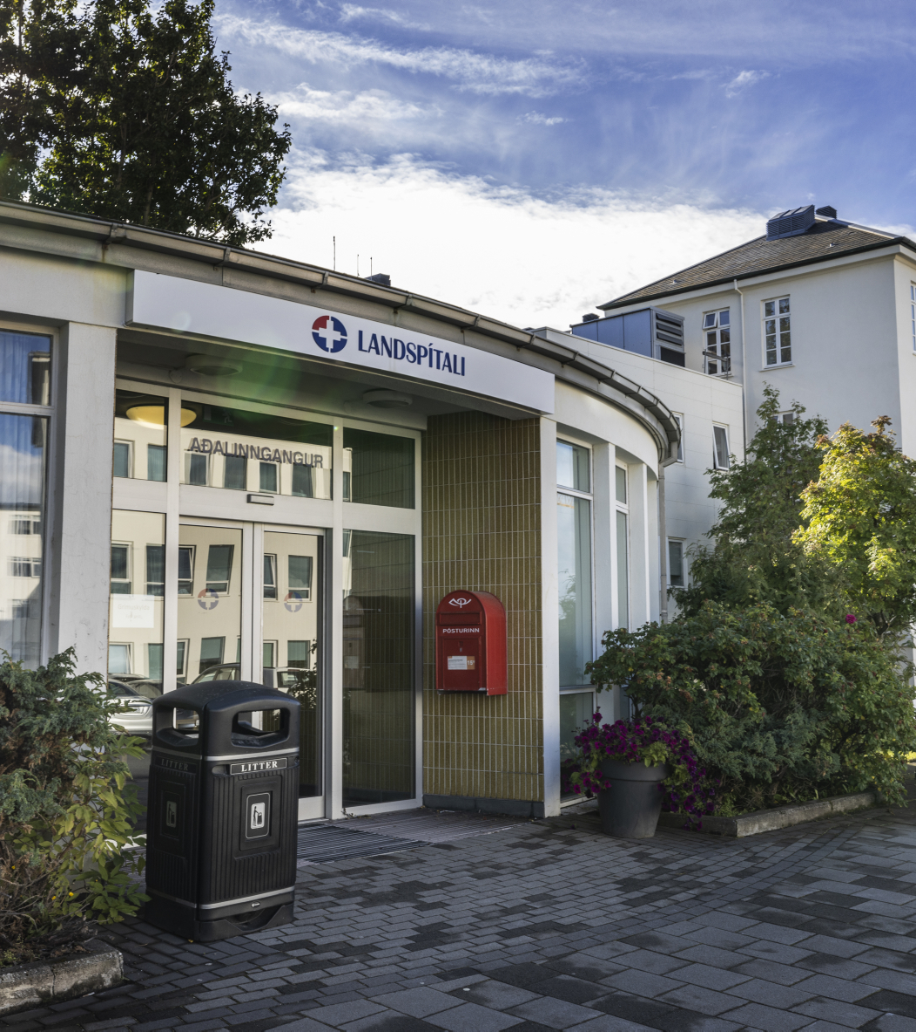
Agenda
Health care in Iceland
Landspítali
  Organization
  Operations
  New Hospital Building

Slide 3
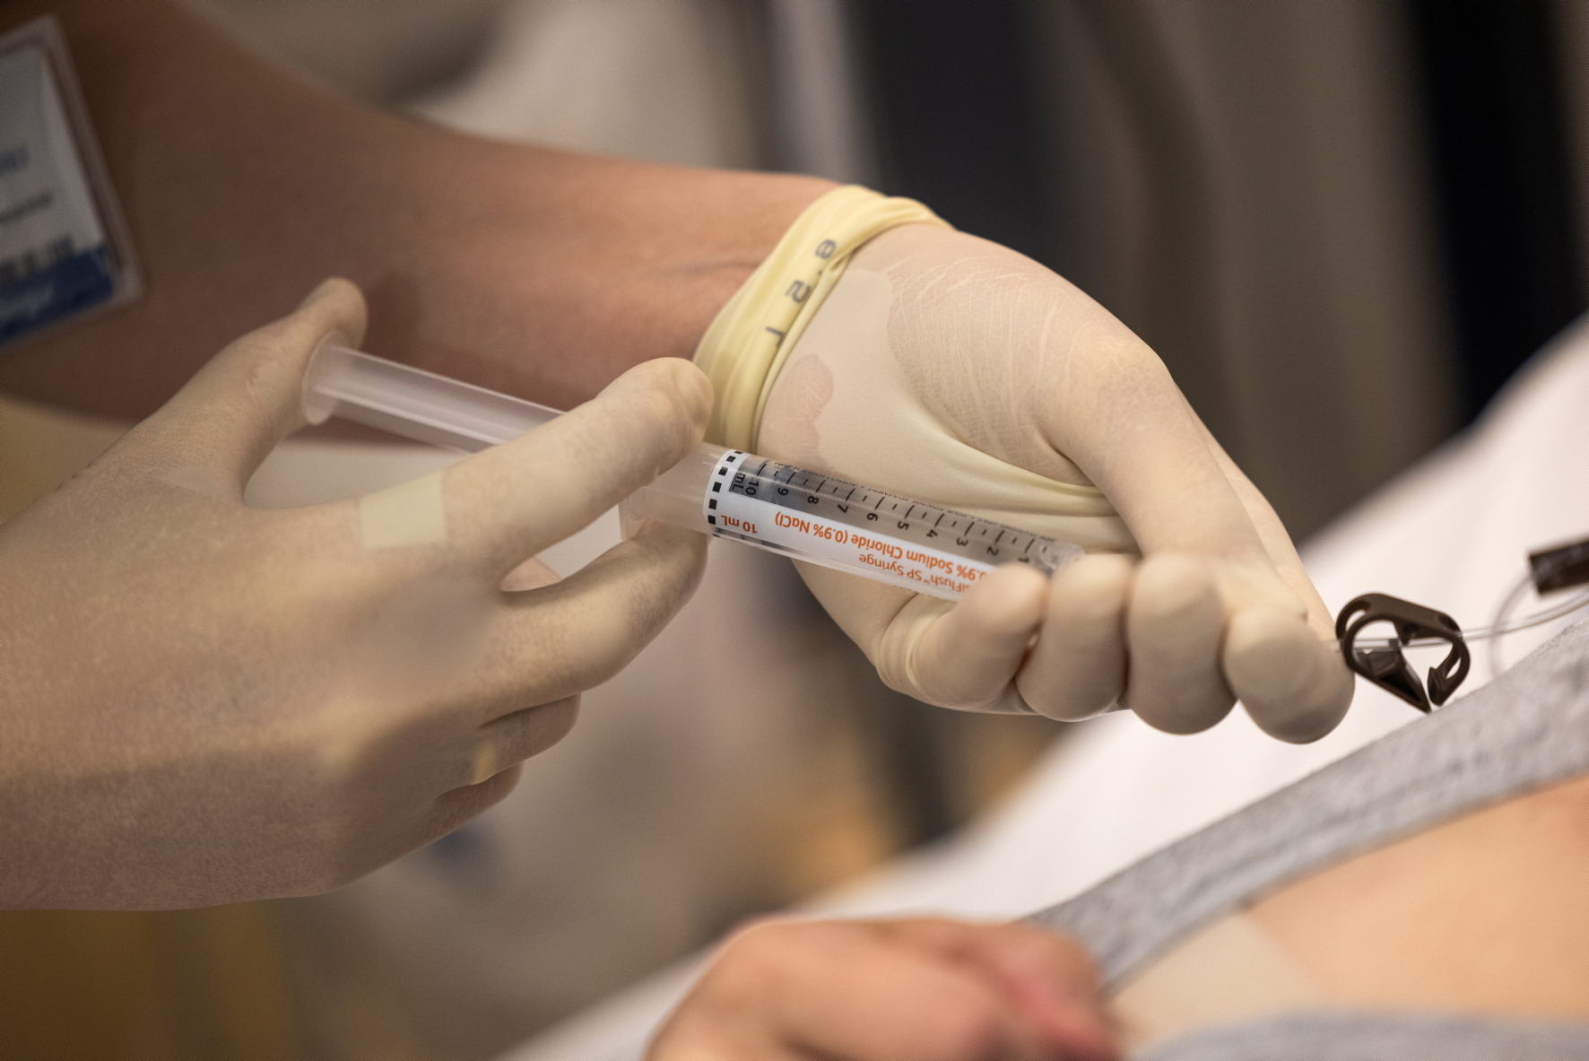
Health care in Iceland

Slide 4

The Icelandic Health care system
Icelandic population
389.000 (Jan. 2025)
249.000 in the capital area
Health sector counts for 8,74% of GDP
Financing of health services
83,7% through taxes and 16,3% by individuals
Good clinical results in comparison to other OECD nations
Good access to services

Slide 5
Low cancer incidence and mortality Iceland vs. OECD
Cancer mortality rates by sex, 2021 (or nearest year)
Source: OECD Health Statistics 2023

Slide 6
Low heart attack and Ischaemic heart disease mortality
Iceland vs. OECD
Heart attacks and other ischaemic heart disease mortality, 2021 and 2011 (or nearest year)
Source: OECD Health Statistics 2023

Slide 7
Low stroke mortality
Iceland vs. OECD
Stroke mortality, 2021 and 2011 (or nearest year)
Source: OECD Health Statistics 2023

Slide 8
Low Covid-19 mortality
COVID-19 mortality for 2020-2022
Sources: COVID-19 deaths from OECD Health Statistics 2023; population data from UNWPP 2022.

Slide 9
The Icelandic Health Care System
One university hospital
One teaching hospital
Several small rural hospitals
  primary care
  nursing homes
Primary health care centres
Private practices
Financing
  National health insurance
  Fixed budgets
  Fee for service, private practices
EHR and diverse clinical information systems
OeBS system for financial and HR processes

Slide 10
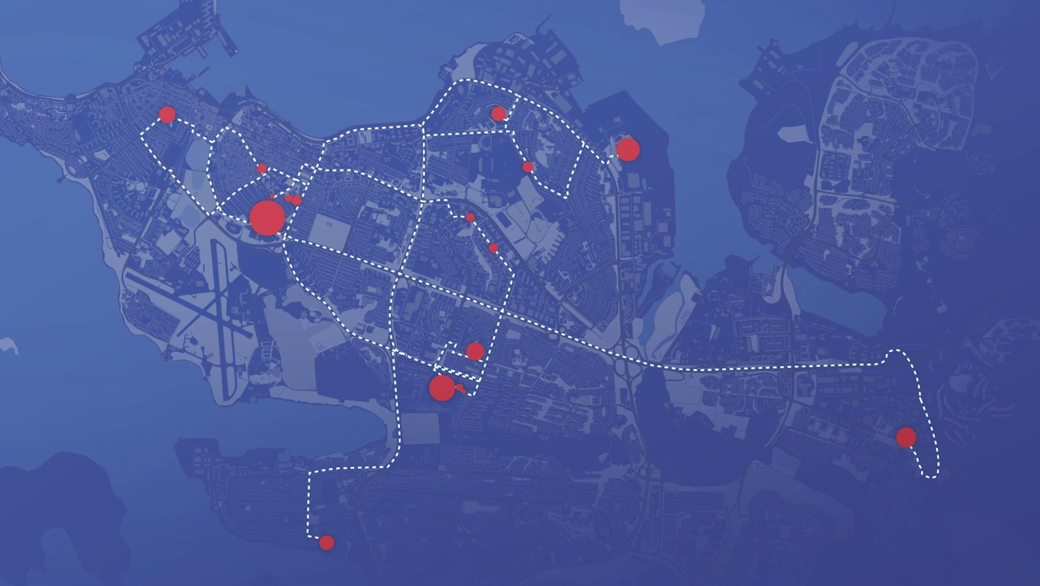
Landspitali
The only university hospital and largest organization in Iceland
6.600 employees
2.000 students
in 100 buildings
on 20 sites in the capital area of Reykjavík
New CEO in 2008, 2010, 2014 and 2022
Major reorganization in 2009, 2015, 2019 and 2023
Created by a series of mergers in 1996, 2000 and 2011

Slide 11
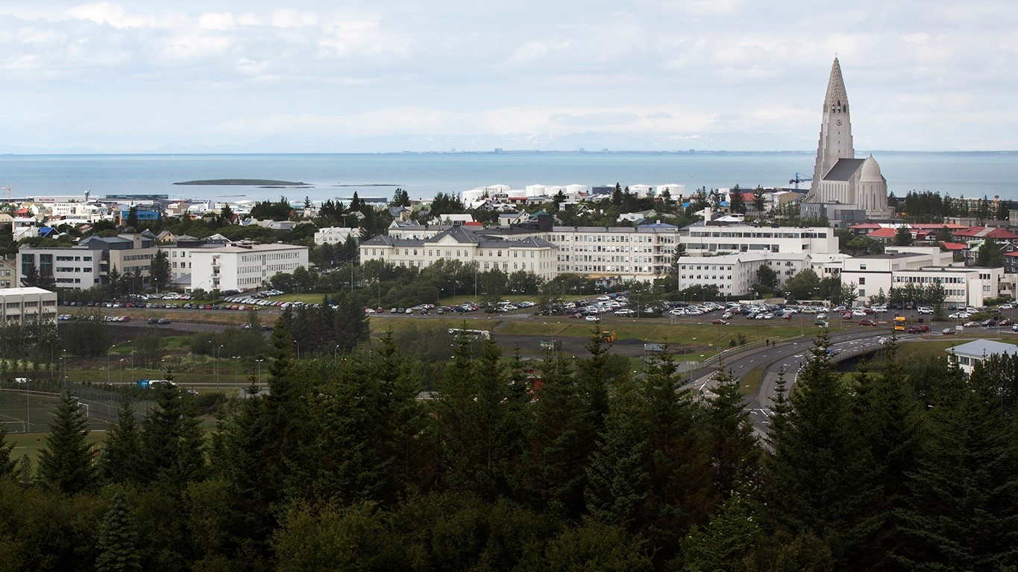
Landspitali - Hringbraut

Slide 12
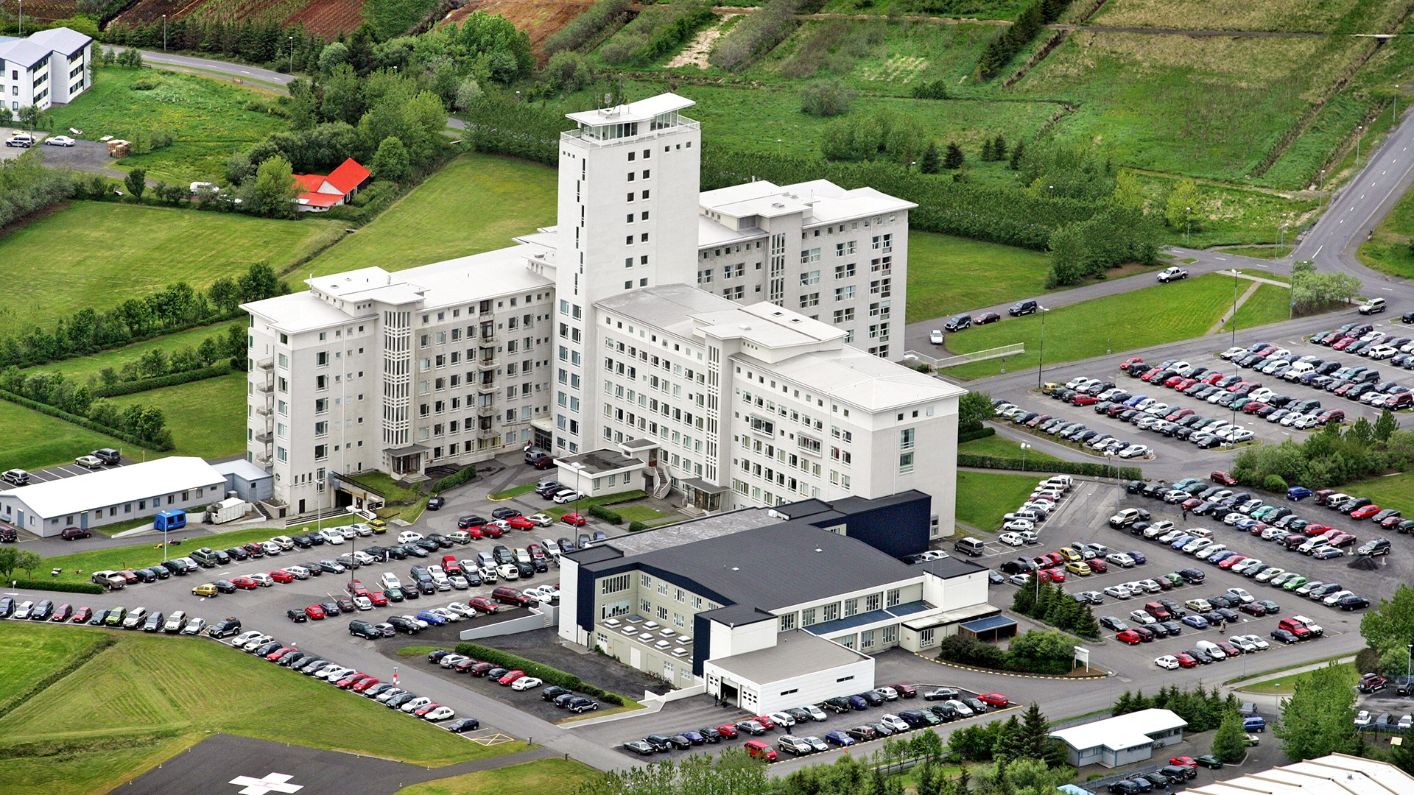
Landspitali - Fossvogur

Slide 13
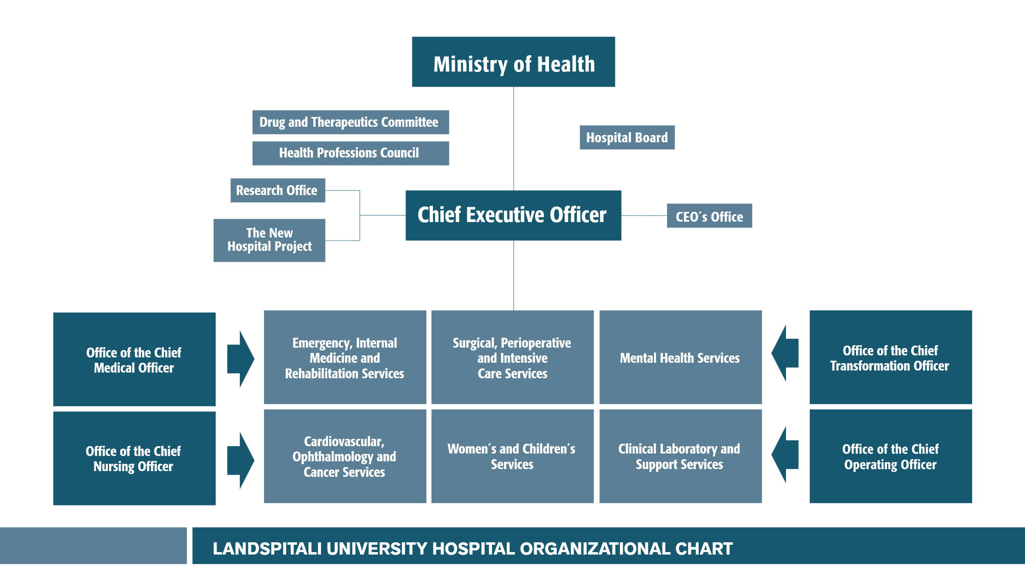

Slide 14
Landspitali
40 medical specialities
  Many subspecialities
Medical speciality training abroad
  Mostly in Sweden, Norway, USA, UK, The Netherlands
Very few patients sent abroad for treatments
  Some heart surgery, some stem cell treatments, PET and solid organ transplants (excl. renal transplants)
Good clinical results
A third of the population served in 2024
Approximately 2.000 students per year
2024 Budget approx. 117 billion ISK
  848 million USD
  784 million EUR

Slide 15
Clinical service
94.600
emergency visits
569.000
outpatient services
26.700
admissions
619
hospital beds
4,9
days average length of stay
14.500
surgical procedures
3.057
births

Slide 16
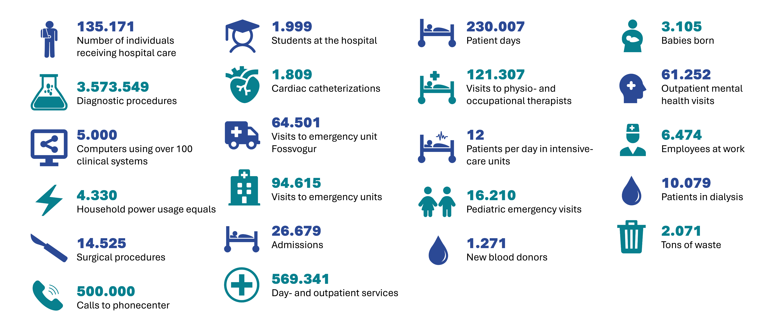
The year 2024 at Landspitali

Slide 17
A typical day at Landspitali
630 inpatients
2.277 day- and outpatient services
73 new admissions
9.790 laboratory tests
477 visits to physio- and occupational therapists
259 emergency unit visits
40 surgical procedures
9 babies born
44 pediatric emergency visits
7 cardiac catheterizations
33 patients in dialysis
221 outpatient mental health services
12 patients in intensive-care units
3.700 employees at work
5,7 tons of waste

Slide 18
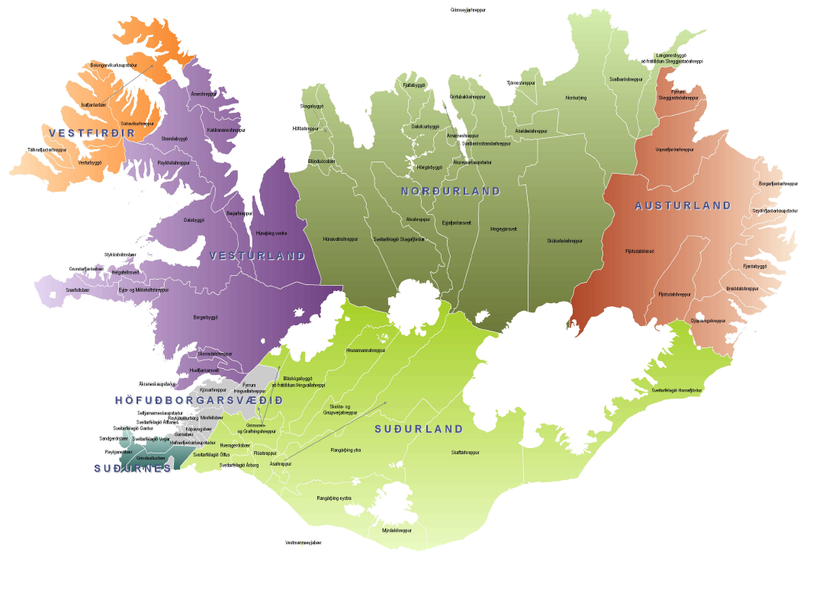
Patients seeking health care service at Landspitali come from all health districts in the country
Reykjavík

Slide 19

Number of individuals receiving hospital care at Landspítali
Approx. 30% of Icelanders every year

Slide 20
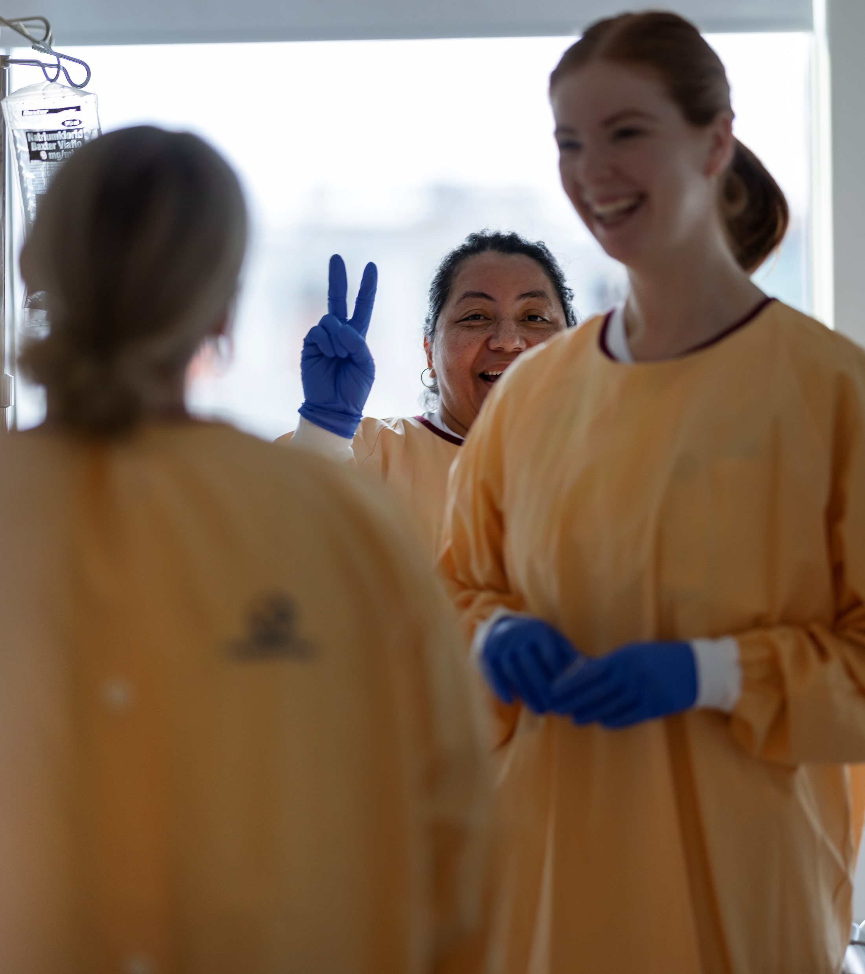
Average length of stay (Days)
(Stays < 30 days)

Slide 21
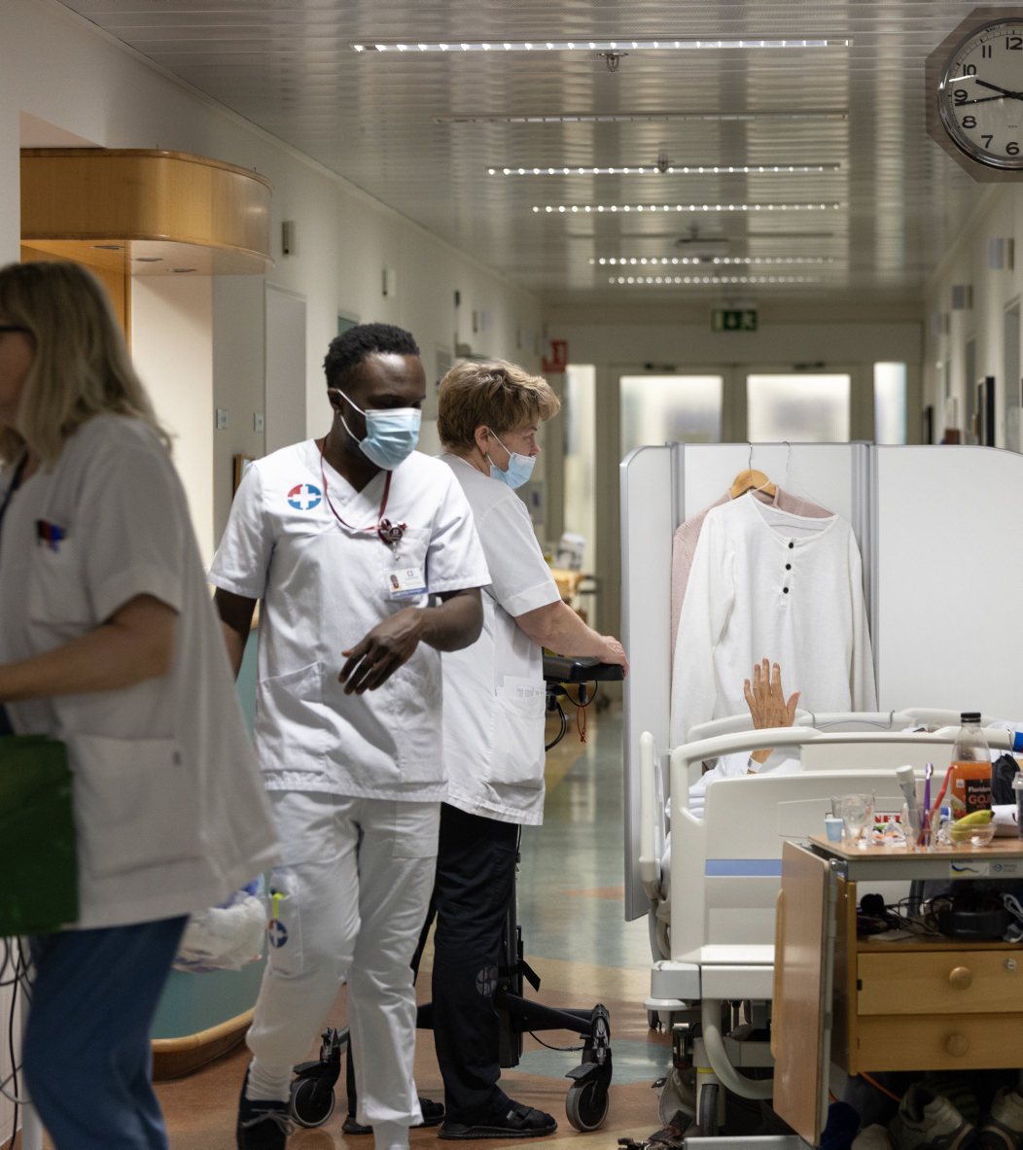
Number of visits to emergency units

Slide 22
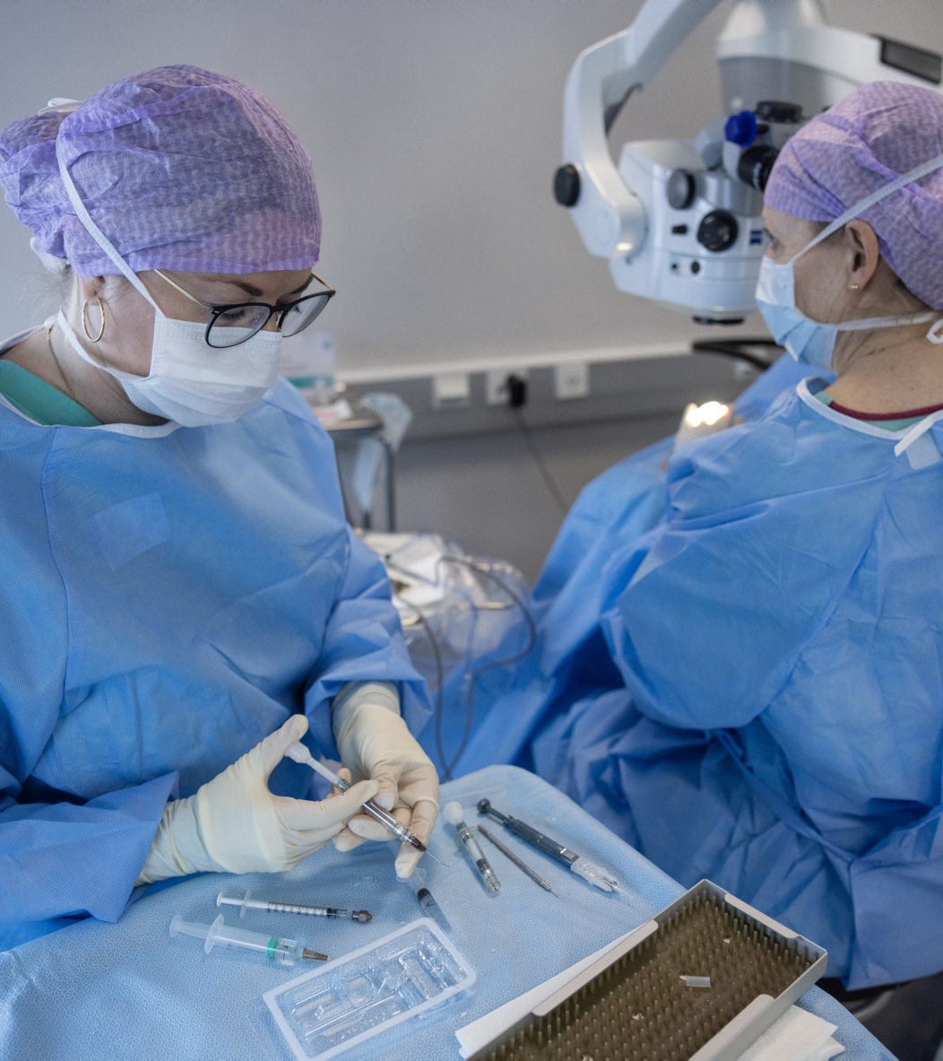
Surgery

Slide 23
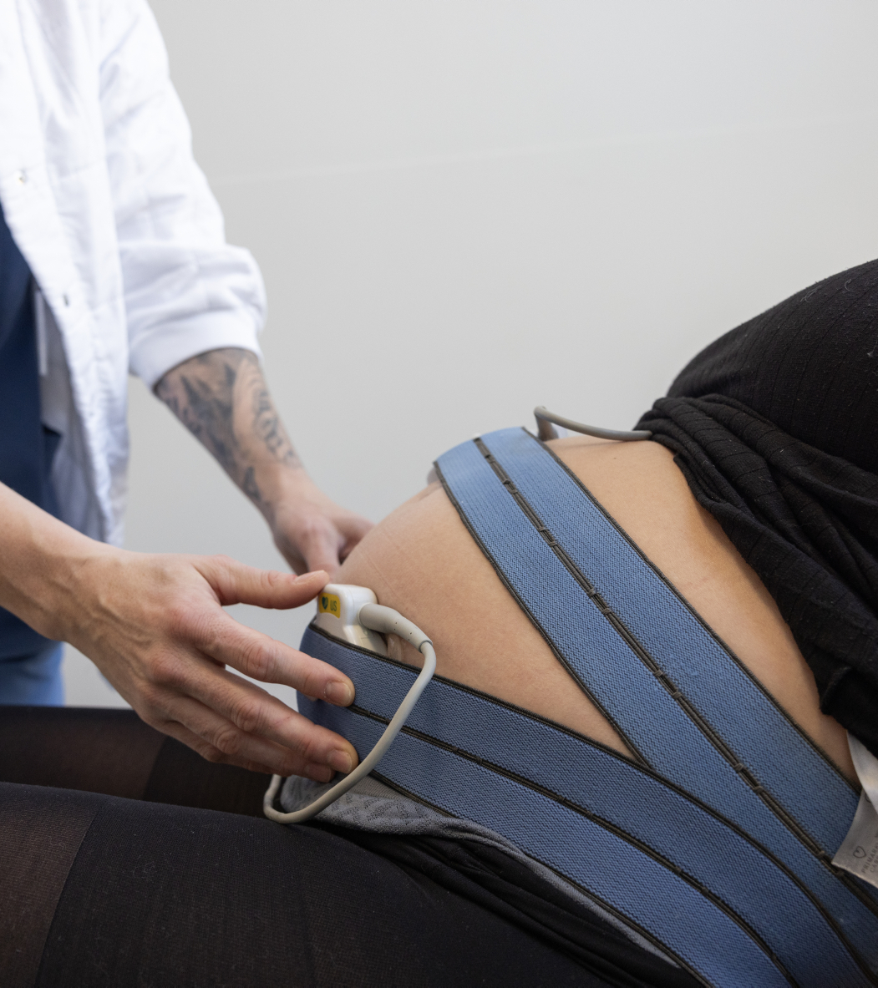
Over 70% of all births in Iceland occur at Landspitali

Slide 24

Proportion of readmissions within 30 days from discharge

Slide 25
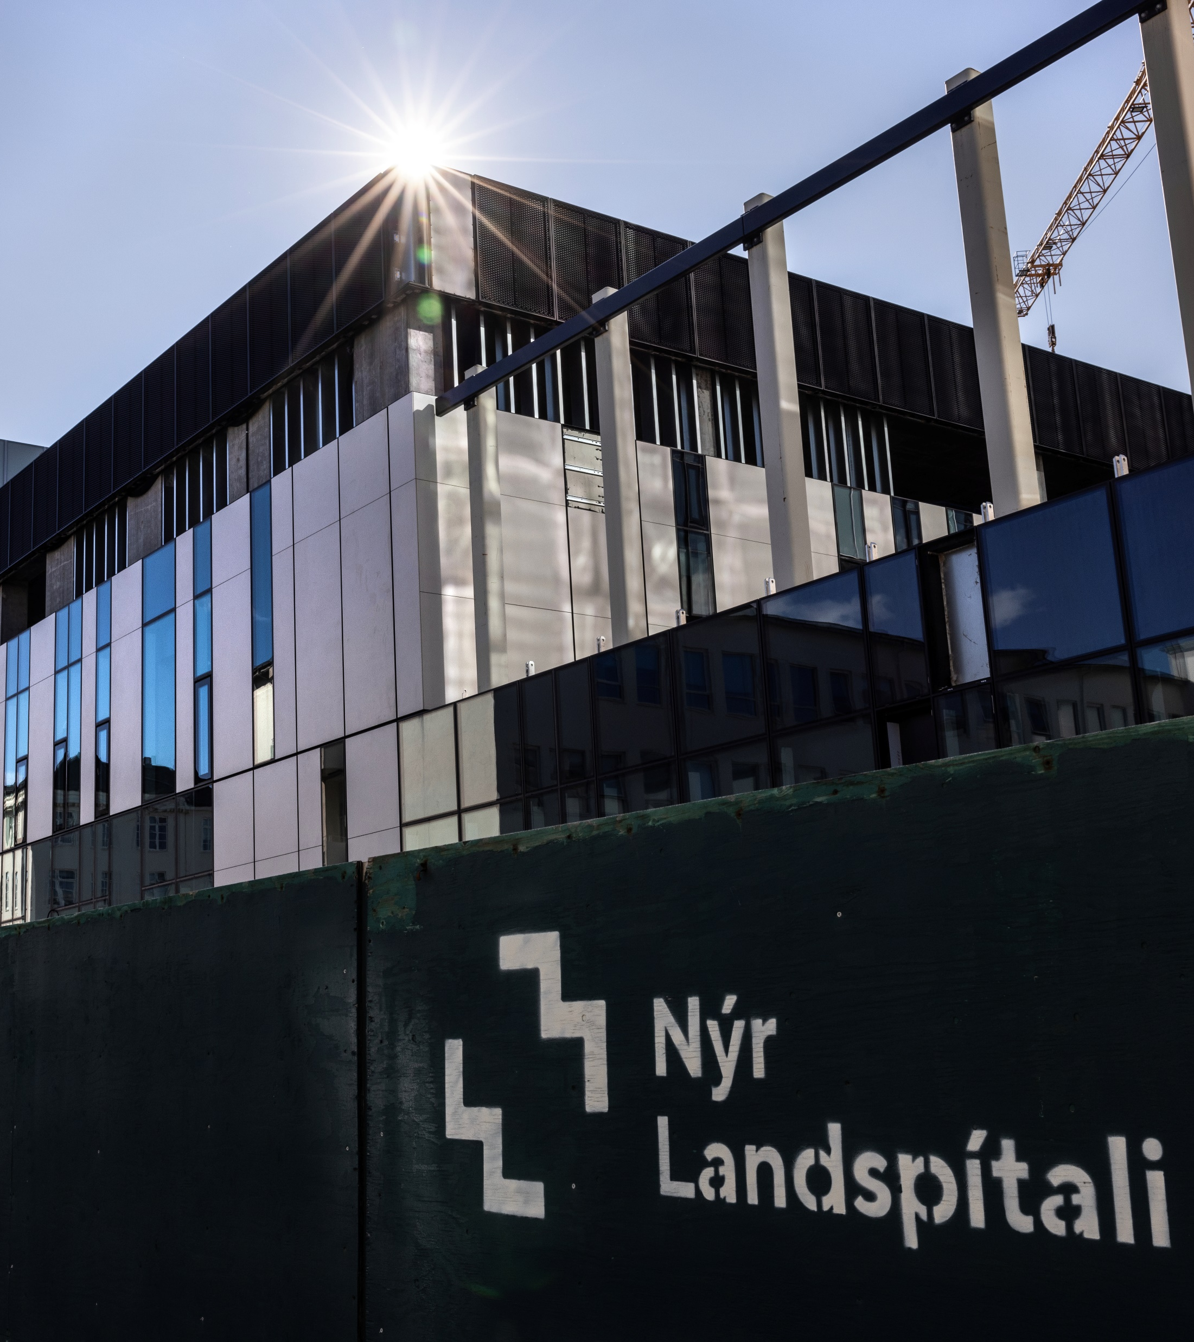
Proportion of deaths during inpatient stay (across all departments)

Slide 26
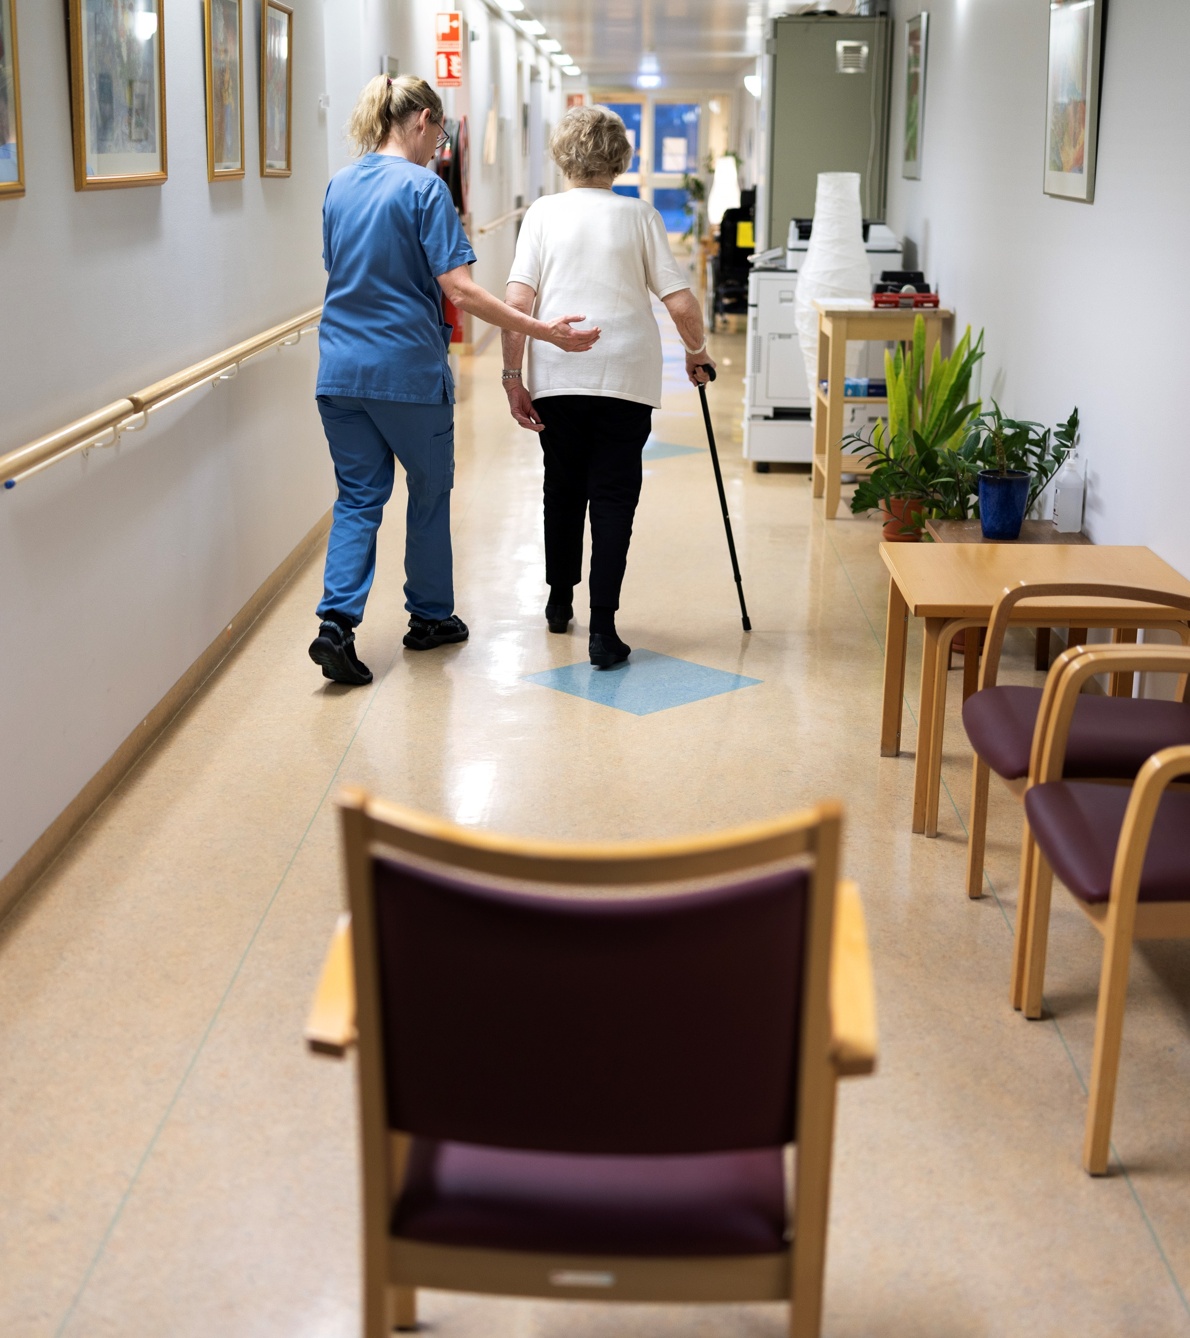
Rate of deaths within 30 days from discharge per 1,000 inpatients

Slide 27
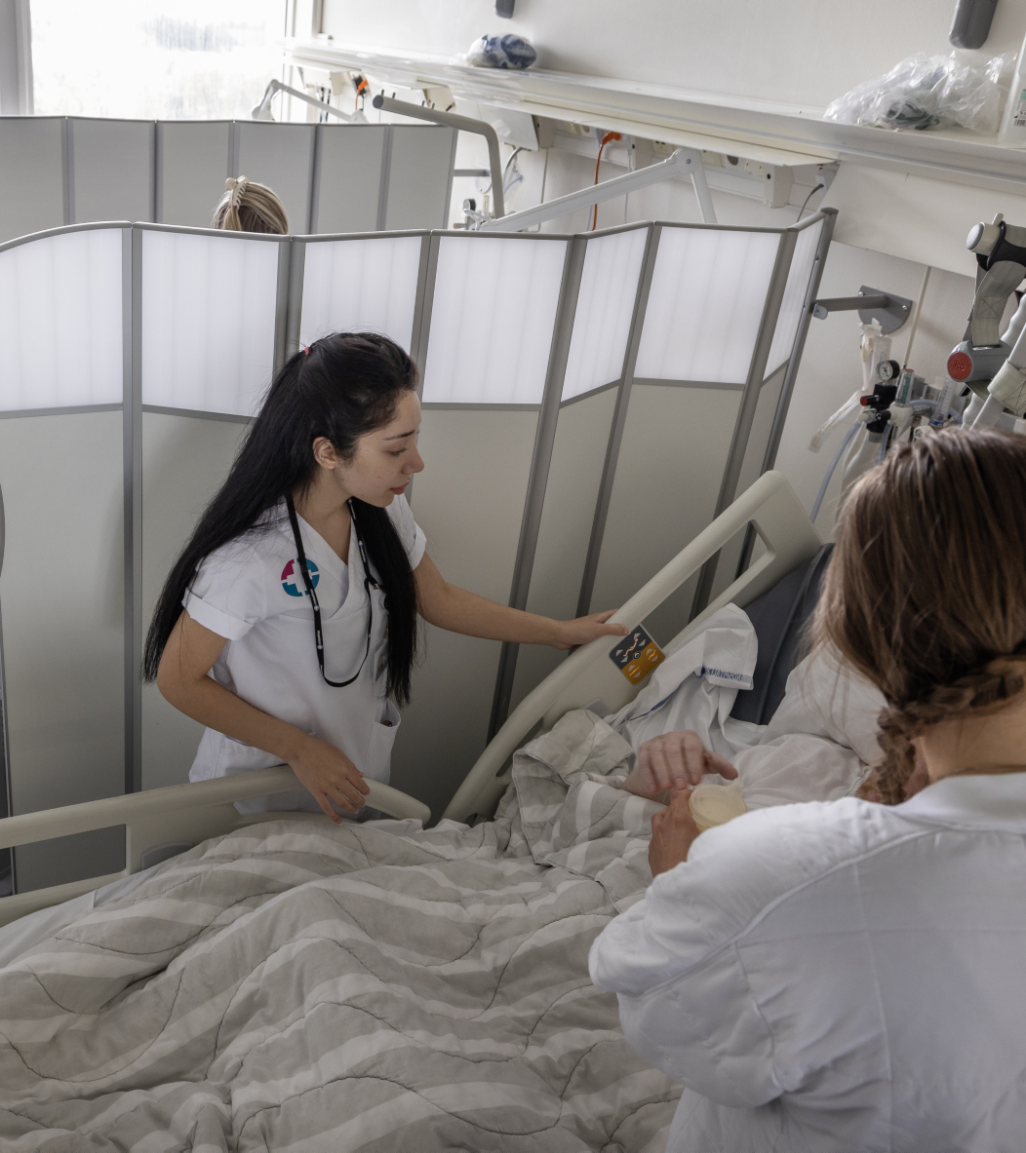

Slide 28

Number of patients per nurse

Slide 29
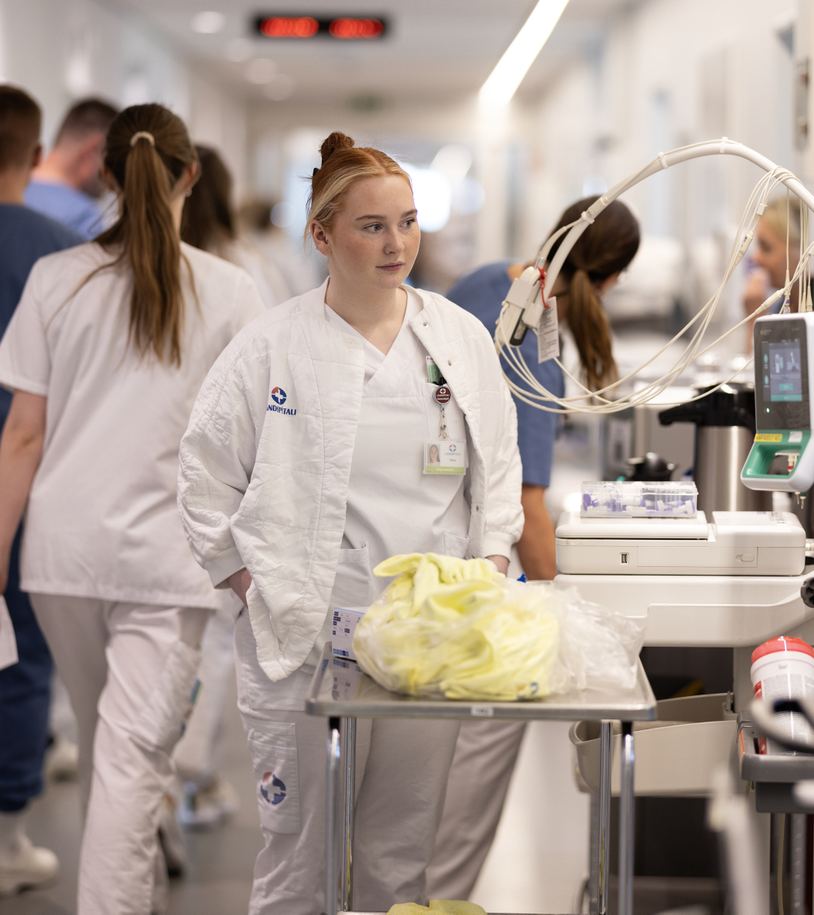

Slide 30
Inpatients; main Diagnostic Categories
(of the DRG system)

Slide 31
Quality indicators: Births

Slide 32
Quality indicators: Neurology
Stroke, mortality within 30 days from admission

Slide 33
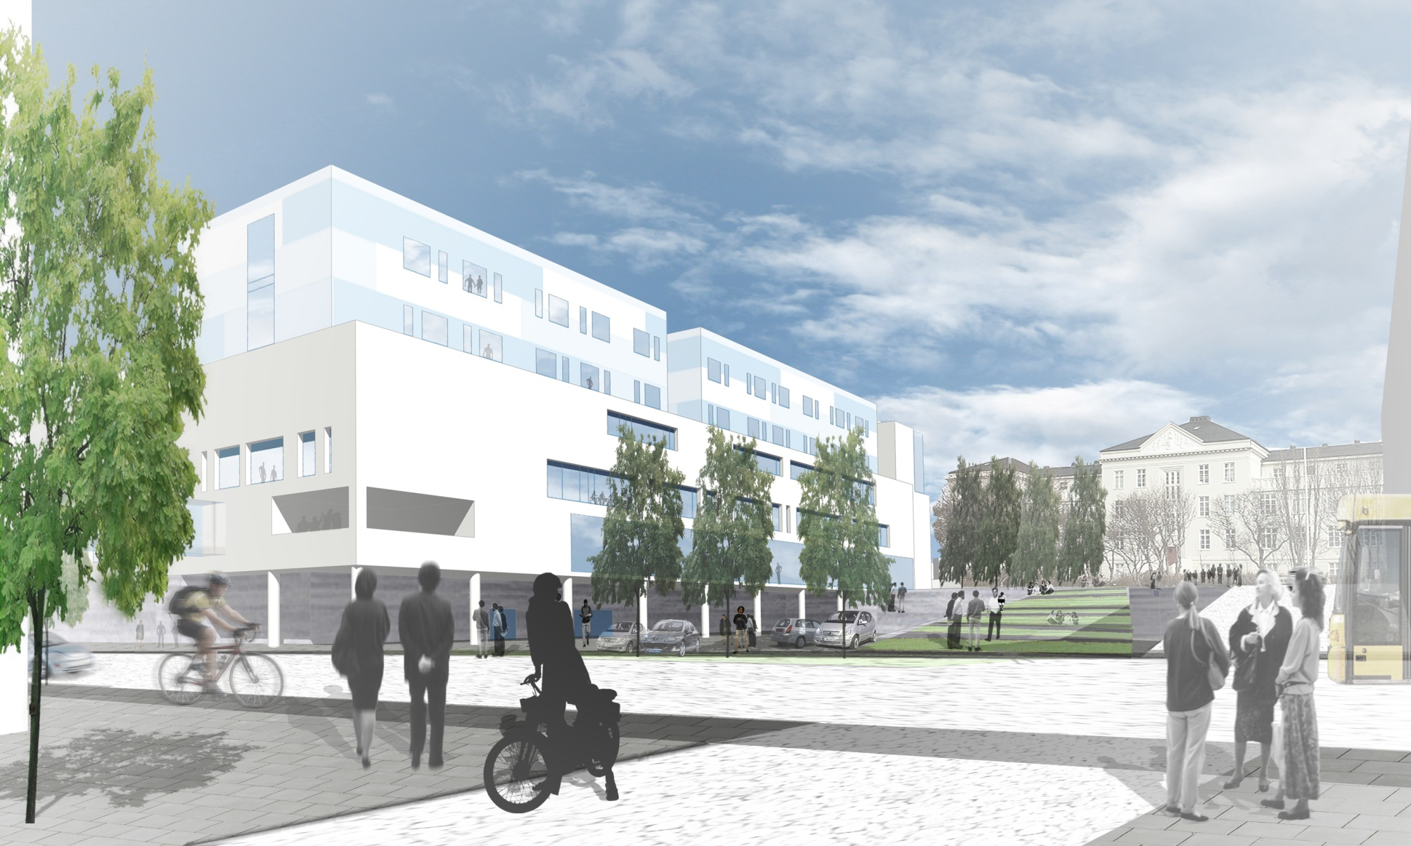
New hospital building

Slide 34
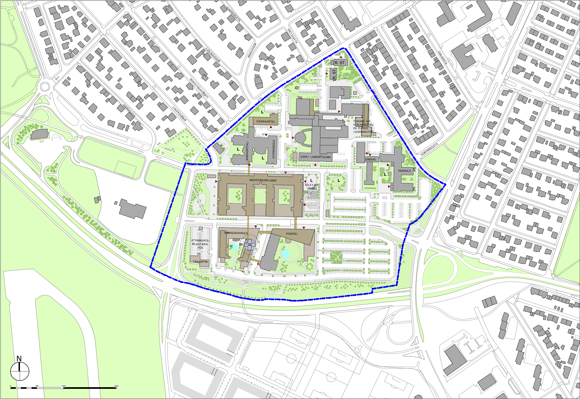
Landspitali – Phase 1

Slide 35
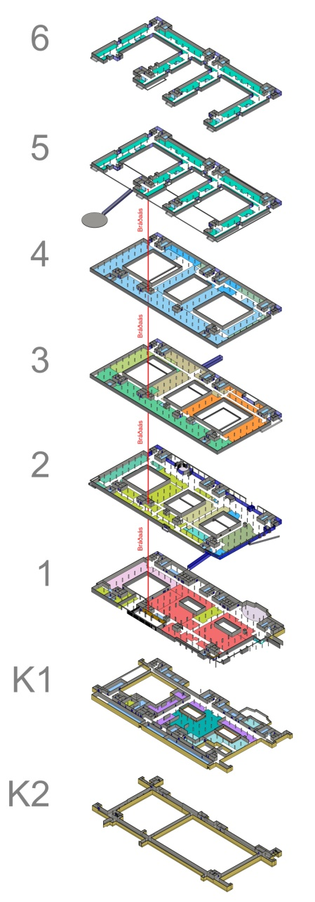
Landspítali – Acute Core/Treatment areas/Bed Wards – 58.500 m²
Bed Wards
Bed Wards
Technical areas / offices
Pre/post, Surgery,
Catherization,
intensive care
Infectious diseases
Diagnostic imaging
Lobby, Cantine
Emerg. Departm.
Pharmacy
PET production
Sterilization
Wardrobes
PET cyclotron
Technical ducts

Slide 36
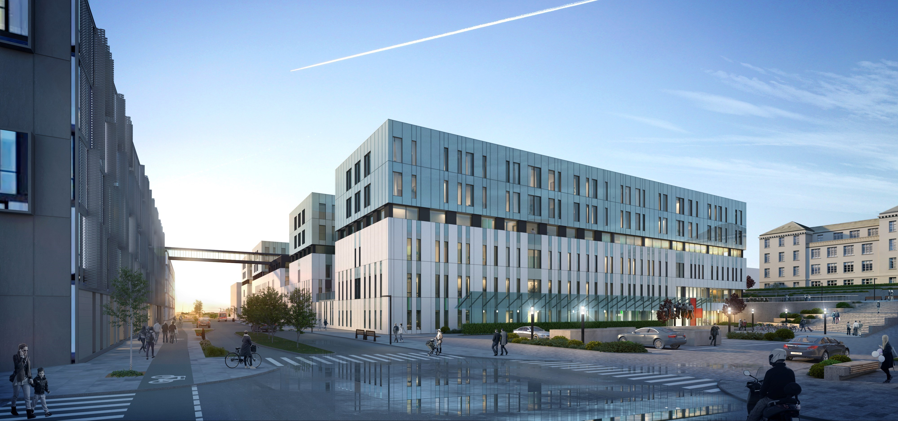

Slide 37
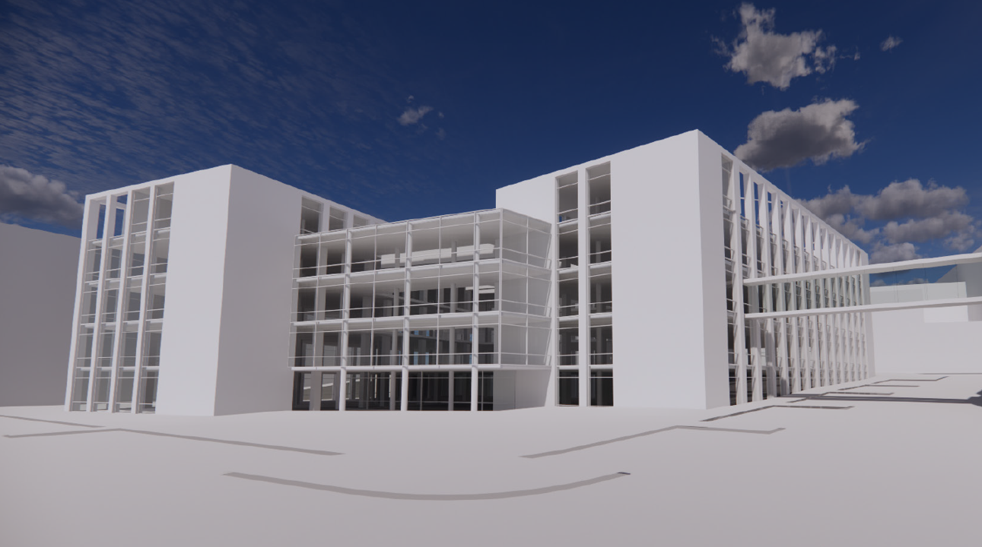

Slide 38
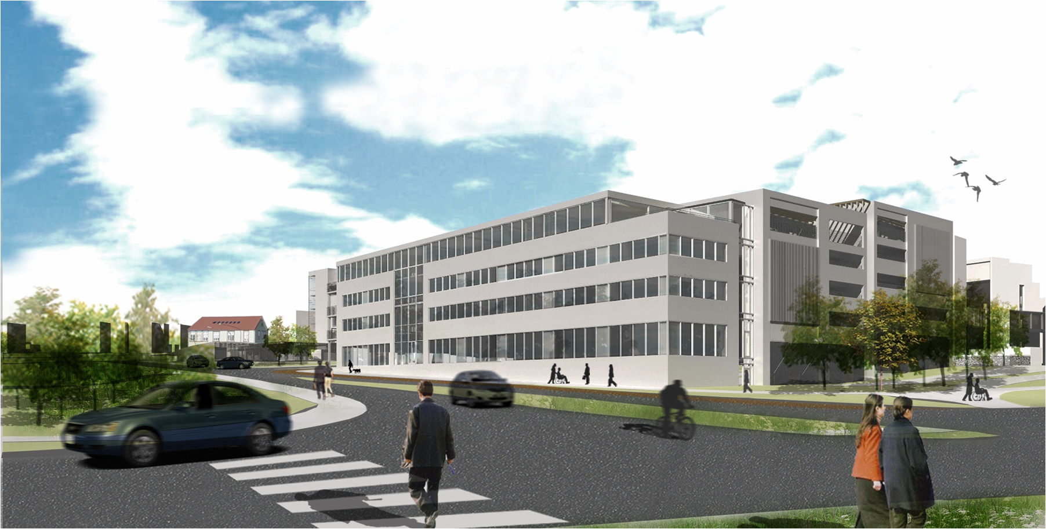

Slide 39
